Slide 1
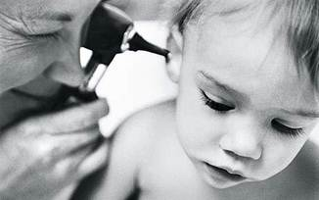
Pendred Syndrome and SLC26A4
Erin Tapper
564, Spring 2014

Slide 2
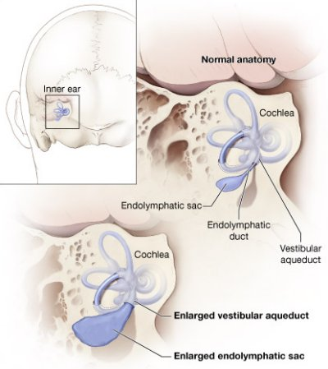
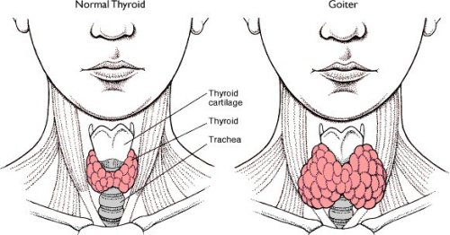
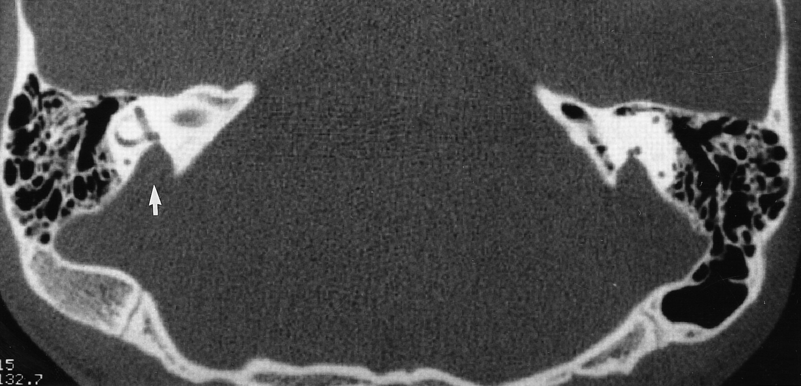
Pendred syndrome
Spectrum disorder
Notes:
7-10% of heritable deafness
First, I’m going to give you some background on Pendred Syndrome. Pendred Syndrome is a hearing loss spectrum disorder with a large range of serverity differing between individuals.
The most prominent symptom is progressive hearing loss, the severity of which ranges by individual.
The hearing loss is due to congenital enlargement of the vestibular aqueduct in the inner ear, causing temporal bone and cochlear malformations resulting in loss of function.
Some individuals also experience adolescent goiter development. In addition to the physical symptoms patients may also experience balance problems, which are likely tied to the inner ear malformations.

Slide 3
What gene is mutated in Pendred syndrome?
SLC26A4
Pendrin
ST
Sulfate transporter with GLY motif
Sulfate_transp
Sulfate transporter family
STAS
Sulfate Transporter and AntiSigma factor antagonist
Notes:
The mutated gene associated with Pendred Syndrome is solute carrier family 26, anion exchanger, member 4 (SLC26A4), which encodes for the transporter protein pendrin. The pendrin sequence in humans is 780 amino acids and after running the sequence through the PFAM program identified 3 domains all of which were sulfate transporter domains. I haven’t mapped out the mutations identified in Pendred Syndrome because there are more

Slide 4
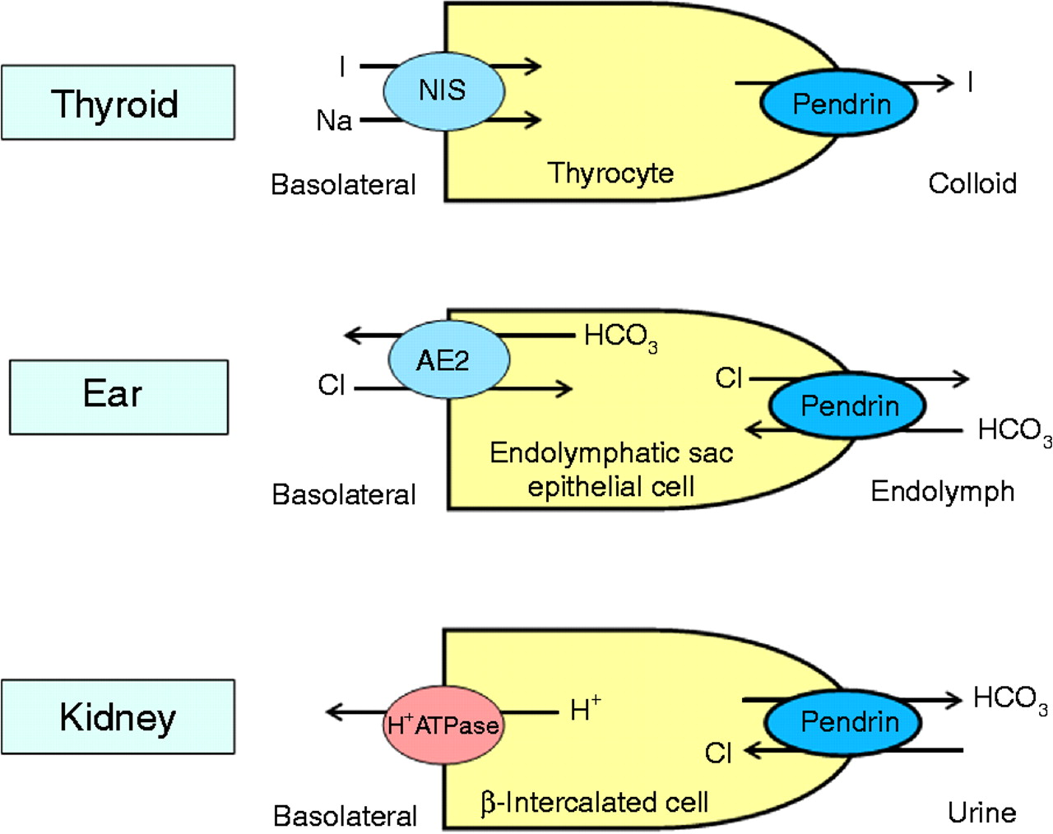
How does Pendrin function in the cell?
ST
CELLULAR COMPONENTS
membranes
BIOLOGICAL PROCESSES
Transport
MOLECULAR FUNCTION
Anion transmembrane transporter activity
Notes:
Based on the domains in pendrin a far stretch to believe that it functions in transport. In terms of gene ontology.. Pendrin localizes to the membranes of epithelial cells and functions in transport, particularly anion transport. BASED ON THE SYMPTOMS OF PENDRED SYNDROME CAN ANYONE GUESS WHICH TISSUES IN PARTICULAR PENDRIN IS LOCALIZING TO? Pendrin localized to the inner ear transports chloride ions and thyroid localized pendrin transports iodide anions.

Slide 5
How does Pendrin function in the inner ear cells?
Cl⁻
Cl⁻
Cl⁻
Cl⁻
Cl⁻
Cl⁻
Cl⁻
Cl⁻
Cl⁻
Cl⁻
Cl⁻
Notes:
Throughout the presentation I will be focusing primarily on pendrin’s function in the inner ear. So here’s a quick pictorial of pendrin function in the inner ear. Pendrin is localized to the membrane of the cell and functions to transport chloride anions out to maintain a healthy cell.

Slide 6
What happens when Pendrin is mutated?
Mutant Pendrin exhibits loss-of-function
Cl⁻
Cl⁻
Cl⁻
Cl⁻
Cl⁻
Cl⁻
Cl⁻
Cl⁻
Cl⁻
Cl⁻
Cl⁻
Notes:
The mutant form of pendrin found in pendred syndrome exhibits a loss of function so when environmental conditions require chloride transport out of the cell pendrin is unable to transport, causing an enlarged cell state subsequently causing enlarged vestibular aqueduct and endolymphatic sac.

Slide 7
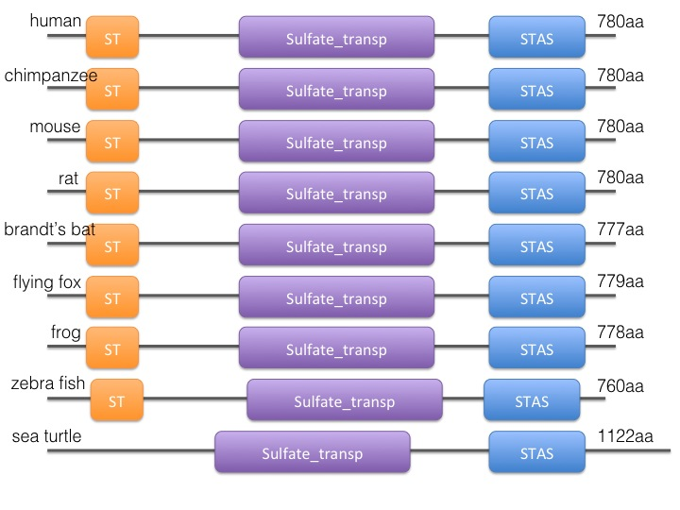
How well conserved is Pendrin?
Identity
99%
87%
85%
88%
84%
68%
57%
76%
Notes:
Looking at homologs and identity we can see that the pendrin protein is very highly conserved in length with high identity between species. I would specificly like to point out that the domains in particular typically varied in location by less than 5 residues and the number of aa is highly conserved as well.

Slide 8
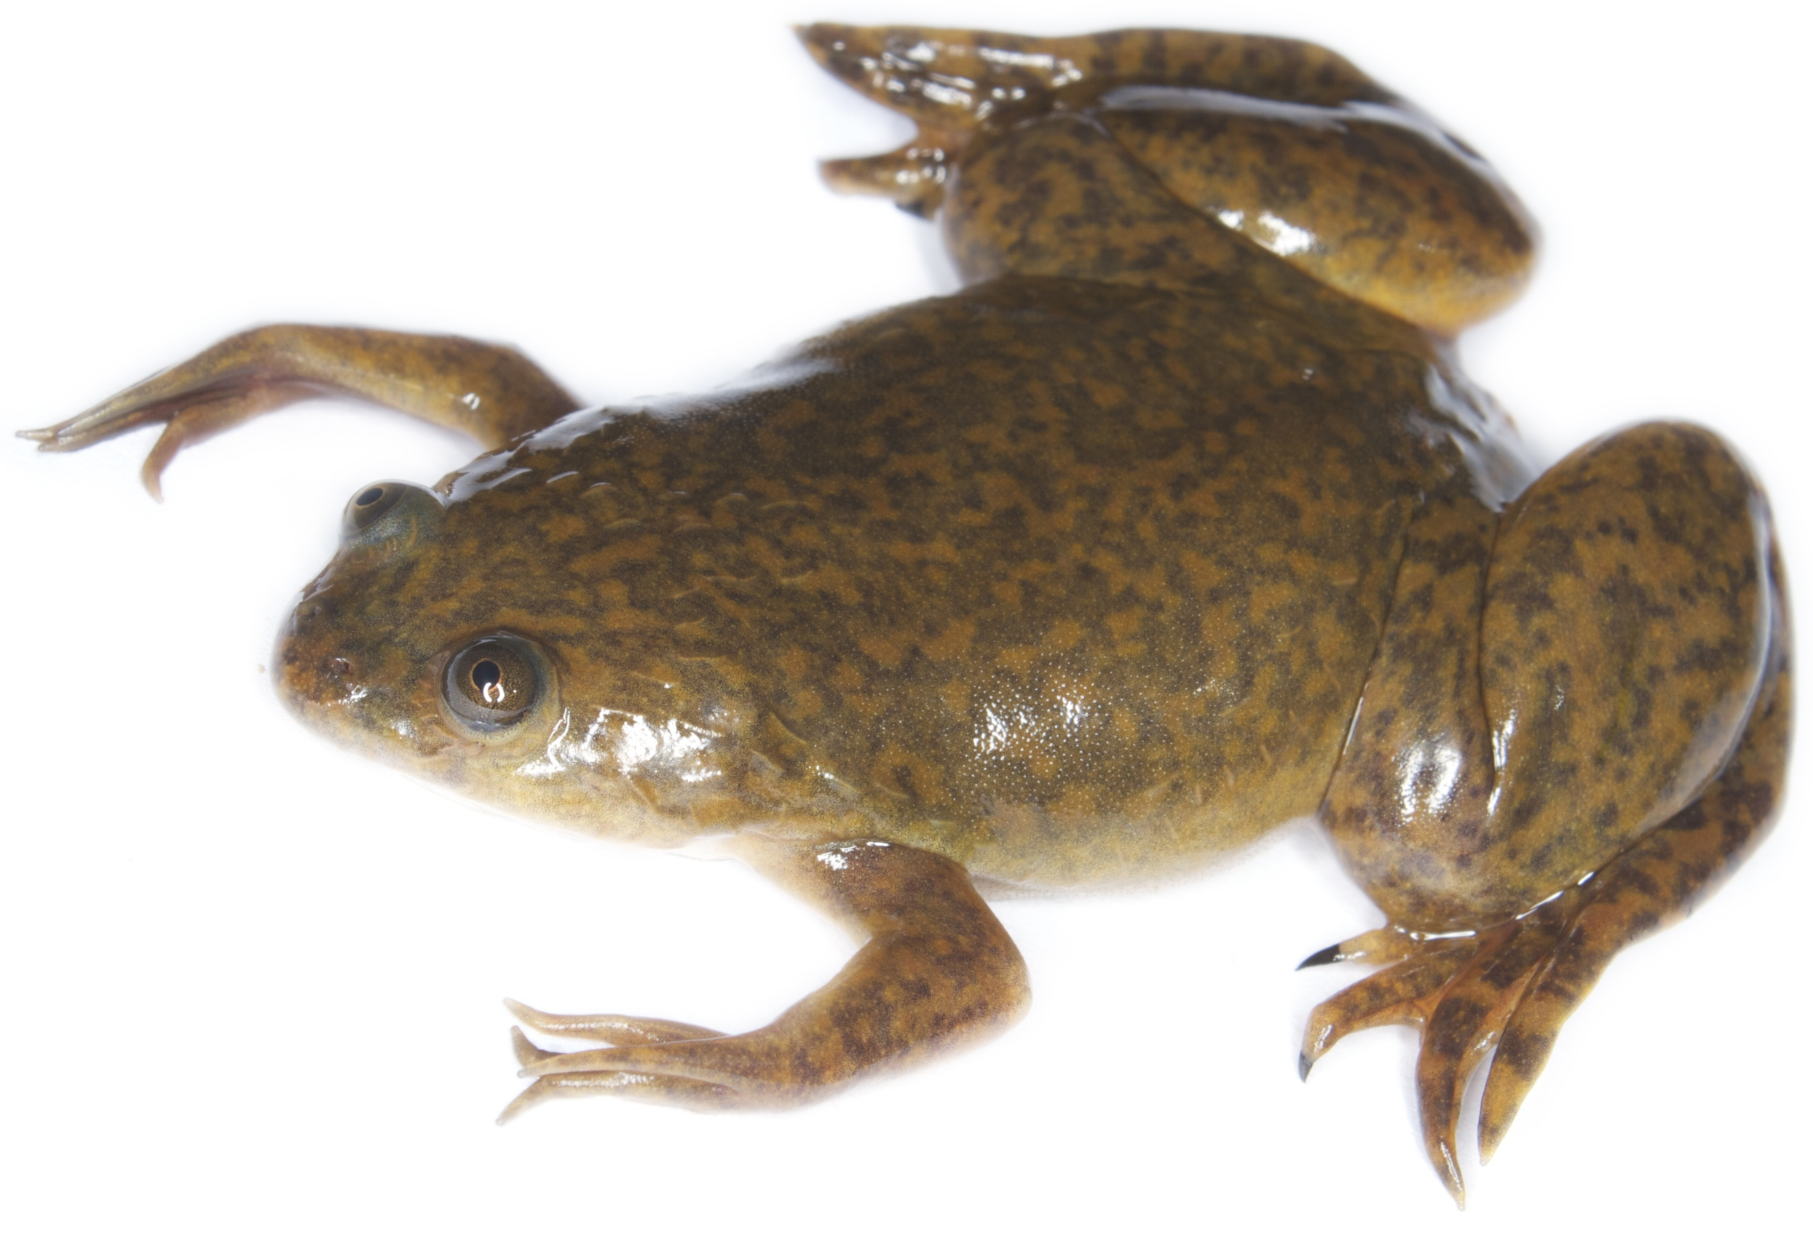
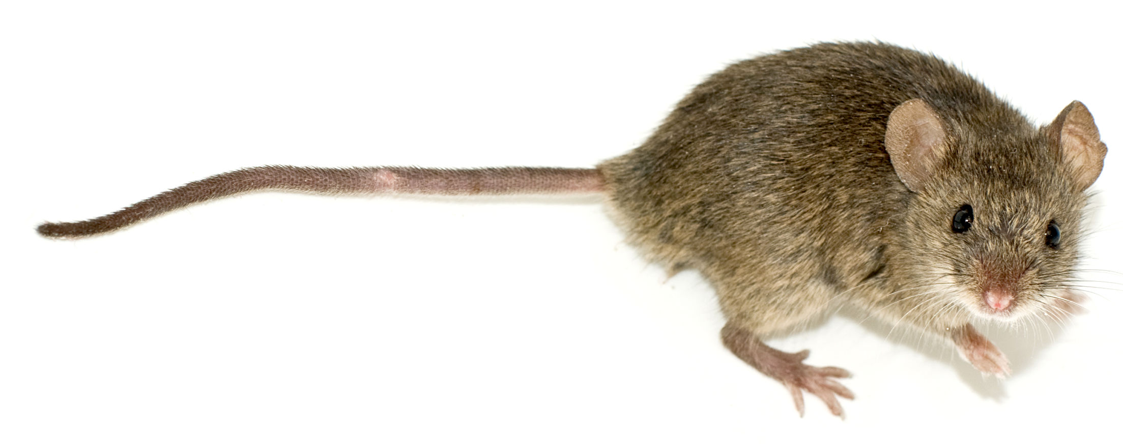
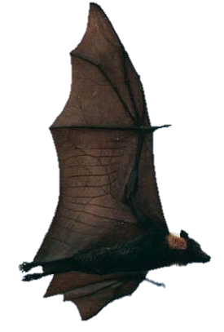
Conservation of Pendrin across species
vibration hearing
“intermediate”
acute hearing
Notes:
Here we have a phylogenetic tree produced by the clustal omega program. I have the species grouped into boxes based on hearing types. In the first box is the zebra fish which has a hearing mechanism which is reliant largly upon sensing vibrations, through a type of sensory organ that senses vibrations in the water. In the second box there is an intermediate mechanism, frogs have something reminiscent of a lateral line and both turtles and frogs have inner ear anatomy but largely hear based on vibration. The third box includes humans, mammals. I specifically chose the mouse, and two different species of bats with differing hearing capabilities. Brandt’s bat uses echolocation, the use of sonar, and the flying fox is a fruit eating bat with insensitive hearing and keen sight and smell, and of course humans. Remember the hearing types because these will be really important in all of my aims

Slide 9
Aim 1: to identify amino acid changes between species
Why? Determine which amino acids are important for Pendrin function in acute hearing
How? MEME alignments
Hypothesis: Residue sequence will be highly conserved in species with similar hearing mechanisms
Notes:
Speaking of aims..my first aim. The understanding we currently have of pendrin is very basic, I wanted to use the sequences of all of the species with different hearing mechanisms to identify the amino acid residues in the pendrin sequence that are important in the acute hearing mechanism, as opposed to the intermediate and vibrational. To analyze this I performed sequence alignments using MEME to identify conserved motifs, and I hypothesized that the residue sequence will be very highly conserved between the species with similar hearing mechanisms.

Slide 10
Aim 1: to identify amino acid changes between species
ST
A
STAS
P
P
……………………………………………………………………………………………………………………………………………………..
……………………………………………………………………………………………………………………………………………………..
P
P
P
Phosphorylation sites are affected by amino acid variability
Variability in bat species sequences
Polar Histidine residues in zebrafish
Notes:
What I found..MEME identified 3 different motifs all in the sulfate transporter family domain. Before I point out any specific sites I want to point out how highly conserved the motifs are, with the large majority of the variabiltiy attributaable to differences in the zebrafish sequence. I have highlighted sequence changes that result in phosphorylation changes, which could influence protein function. Also of importance in all of the alignments there are only 3 residue differences that differentiate the 2 bat species, Isoleucine to leucine and phenylalanine to luecine in this motif. Also of note are the polar histidine residues in the zebra fish sequence, when other species have charged lysine.

Slide 11
Aim 1: to identify amino acid changes between species
ST
B
STAS
P
P
P
P
……………………………………………………………………………………………………………………………………………………..
……………………………………………………………………………………………………………………………………………………..
P
P
P
Phosphorylation sites are affected by amino acid variability
Variability in bat species sequences
Notes:
The second motif, again very high conservation but we see changes in phosphorylatable residues, as well as an isoluecine and valine change between the bat species and sequence difference in zebrashish and sea turtle and frog

Slide 12
Aim 1: to identify amino acid changes between species
ST
C
STAS
P
P
……………………………………………………………………………………………………………………………………………………..
……………………………………………………………………………………………………………………………………………………..
P
P
P
Phosphorylation sites are affected by amino acid variability
Results: Sequence variability between hearing types
Notes:
In the third domain more of the same, high conservation with changes in phosphorylation sites and amino acid differences in the zebra fish sequence. The incredible conservation of the domains allows us to more easily identify amino acids that may be important to pendrin function, and in further studies experiment on gene therapies.

Slide 13
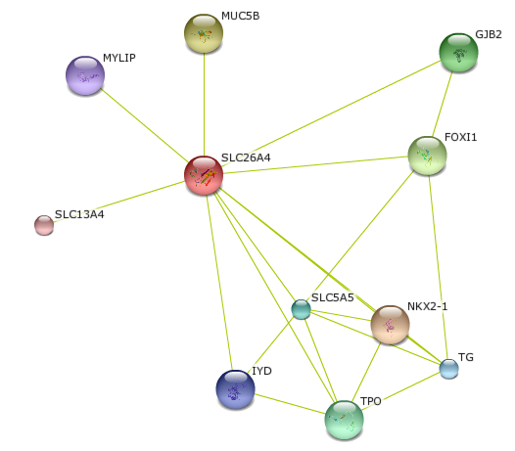
Aim 2: Identifying interaction partners in species with acute hearing
Why? Amino acid changes and differences in hearing mechanisms likely cause interaction partner changes
Hearing
How? Yeast-2-Hybrid and
TAP-tag analysis
Thyroid
Hypothesis: Interaction partners will differ between species with different hearing mechanisms
Notes:
In my second aim I going to compare the interacting partners pendrin in species with different hearing mechanisms. By subjecting the different pendrins to a preliminary y-2h to find interaction partners and then perform TAP-tag analysis based on y2h results. I hypothesize that the interaction partners will vary by hearing mechanism, so for example the zebra fish pendrin will have different interaction partners than the bat and human.
Amino acid changes→interaction partner changes
MYLIP=chloesterol regulation
MUC5B=major gel-forming mucin in mucus
IYD=congenital hypothyroidism
TPO=congenital goiter
GJB2=localizes to cochlea, unknown function

Slide 14
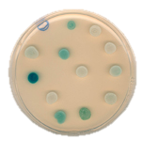
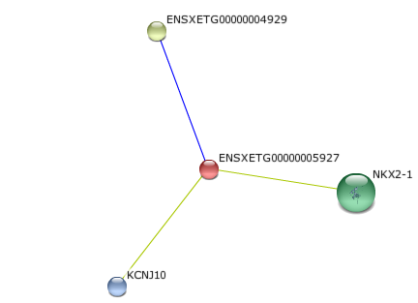
Aim 2: Identifying interaction partners in species with acute hearing
Yeast-2-hybrid
TAP-tag
Which are specific to acute hearing organisms?
Notes:
Here is a quick summary of the expected results, with the zebrafish having a different hearing mechanism and likely different interaction partners as well.

Slide 15
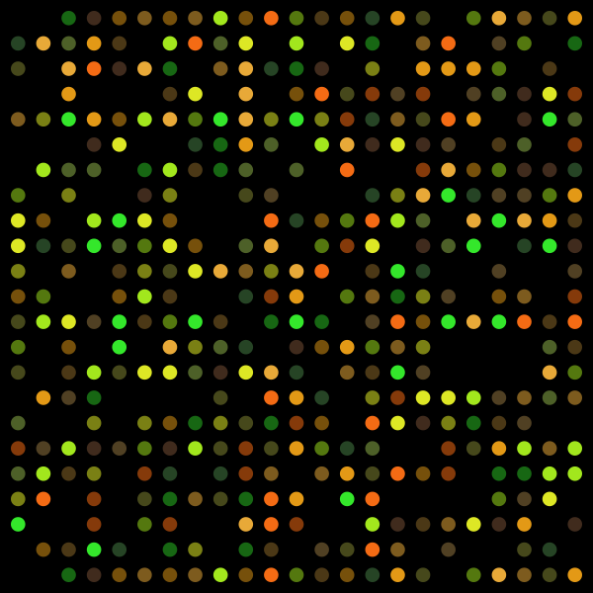
Aim 3: to identify proteins regulated by Pendrin
Why? Understanding of Pendrin’s role in development is limited
How? Microarray analysis
Hypothesis: Knockdown of Pendrin will influence expression levels of other developmental genes
MUT/MUT
Wild-type
Notes:
In my third and final aim I wanted to investigate the role of pendrin in development and on other developmental genes by conducting a microarray analysis using mice for the study. I hypothesize that knockdown of pendrin will influence the expression of other developmental genes.

Slide 16
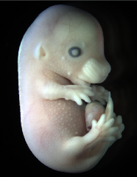
Aim 3: Microarray assay of developmental interaction partners of Pendrin
Developmental gene expression levels
Change in gene patterns after the start of ear development?
Affects in developmental, hearing, and thyroid genes?
Notes:
Microarray analysis of expression throughout embryonic and fetal development—important to start before Inner ear starts developing at 10.7 days post coital. Test into adolescence for thyroid interaction partners.

Slide 17
Future Directions
Gene therapy
amino acid variation affect on hearing
Interaction partner regulation
knockdowns of interaction
partners

Slide 18
?

Slide 19
References
Title slide credit: http://www.telegraph.co.uk/culture/9526045/Why-not-all-deaf-people-want-to-be-cured.html
[1] Genetics Home Reference: Pendred Syndrome
[2] Du, W., et al. (2013). A systematic review and meta-analysis of common mutations of SLC26A4 gene in Asian populations. International Journal of Pediatric Otorhinolaryngology 77 (2013) 1670-1676. doi: 10.1016/j.ijporl.2013.07.023
[3] Li, X., et al. (2013). SLC26A4 Targeted to the Endolymphatic Sac Rescues Hearing and Balance in Slc26a4 Mutant Mice. PLOS Genetics 9(7): e1003641. doi: 10.1371/journal.pgen.1003641
[4] Miyagawa, M., et al. (2014). Mutation spectrum and genotype-phenotype correlation of hearing loss patients caused by SLC26A4 mutations in the Japanese: a large cohort study. Journal of Human Genetics. doi: 10.1038/jhg.2014.12
[5] Lai, C., et al. (2007). Analysis of the SLC26A4 gene in patients with Pendred syndrome in Taiwan. Metabolism Clinical and Experimental 56 (2007): 1279-1284. doi:10.1016/j.metabol.2007.05.013
[6] Yao, G., et al. (2013). Compound heterozygous mutations of SLC26A4 in 4 Chinese families with enlarged vestibular aqueduct. International Journal of Pediatric Otorhinolaryngology 77 (2013) 544-549. doi: 10.1016/j.ijporl.2013.01.002
[7] Wangemann, P. (2013). Mouse Models for Pendrin-Associated Loss of Cochlear and Vestibular Function. Cell Physiol Biochem 2013;32(suppl 1):157-165. doi: 10.1159/000356635
[8] Griffith A, Wangemann P. (2011). Hearin loss associated with enlargement of the vestibular aqueduct: Mechanistic insights from clinical phenotypes, genotypes, and mouse models. Hearing Reasearch 281 (2011) 11-17. doi:10.1016/j.heares.2011.05.009
[9] Choi, BY, et al. (2011). Mouse model of enlarged vestibular aqueducts defines temporal requirement of Slc26a4 expression for hearing acquisition. J Clin Invest. 2011;121(11):4516-4525. doi:10.1172/JCI59353
Images
Inner ear diagram: https://www.nidcd.nih.gov/health/hearing/pages/eva.aspx
Child: http://www.thehealthage.com/2010/04/gene-causes-childhood-deafness-is-detected/
Temporal MRI: http://qjmed.oxfordjournals.org/content/93/2/99.long
Thyroid: http://nandabooks.blogspot.com/2012/10/nursing-care-plan-for-goiter-assessment.html
Y-2-H: http://www.imbb.forth.gr/people/delidakis/
Mouse 1: http://www.emouseatlas.org/emap/home.html
Mouse 2: http://pestcontrolmk.co.uk/rodent-control-milton-keynes-area/
Mouse 3: http://en.wikipedia.org/wiki/Mouse
Bat: http://mammals.biodiversityireland.ie/images/species/fullsize/Brandts%20bat%20(F.%20Greenaway)%20Copyright%20NPWS.jpg
Harry Styles: http://www.huffingtonpost.co.uk/2013/10/15/harry-styles-rosie-huntington-whiteley-one-direction_n_4099875.html
Zebrafish: http://www.petsmart.com/live-pet/live-fish/zebra-danio-zid36-15274/cat-36-catid-700002
Frog:http://en.wikipedia.org/wiki/African_clawed_frog
Sea Turtle: http://www.rsmas.miami.edu/blog/wp-content/uploads/2011/12/Green-Sea-Turtle-061022-French-Reef-KL-IMG_4313.jpg
Mouse newborn: http://upload.wikimedia.org/wikipedia/commons/0/05/Day-old_mice.JPG
Flying fox: http://gokids.com.au/spectacled-flying-fox

